Slide 1

DriverPass System Analysis
Amauri Hopewell
Notes:
[No speaker notes required for this slide.]

Slide 2

System Requirements
Functional Requirements:
The system shall allow regular and secure updates by the DMV to the list of rules in the system’s database.
The system shall allow a user to login by entering the password, and force a reset after 3 incorrect attempts.
Nonfunctional Requirements:
The application should have a low-latency dedicated server for hosting.
The application should be regularly updated depending on the DriverPass owner’s requirements.
Notes:
DriverPass, like many software systems, need’s to translate an expert business owner’s vision into a program that is not only technically sound but also pleasing to customers and the business owner. The first functional requirement, allowing the DMV to directly update a database of rules that can be viewed by students, allows DriverPass to always have cutting-edge lessons. And sourcing it directly from the DMV ensures accuracy and eliminates the need to perform web scraping. The second functional requirement, allowing a login and resetting after failed attempts, is at the heart of the system. Users must be able to login to book appointments, pay bills, and view lessons. But without the forced reset, the system might not be secure enough.
DriverPass does not exist in a vacuum, and needs the right hardware and maintenance to support it. It needs a server with fast connections to host the program and allow users and instructors to access it reliable. It also needs to be regularly updated based on collaboration with DriverPass’s owner, who is in the best position to identify new business needs as they arise.

Slide 3
Use Case Diagram
[Insert your use case diagram here.]
Notes:
This diagram shows how DriverPass will function at a high level. Even though the software seems simple, it will be used by many different types of people.
Both students and instructors need to be able to login to the system, and the system needs to ensure they enter their password correctly. They should also be able to reset their password if needed, because it is easy to forget all the different logins and passwords used in modern life.
The instructor also needs to be able to take notes on student performance. Sometimes, especially when driving, the instructor will be in an area with poor signal or no internet connection, and should be able to upload the notes to the account later when there is a good connection.
The student of course must be able to book appointments, and this requires keeping a central list of appointments in a calendar, to help the student schedule at a good time or keep an eye out for new openings. The student should also be able to view the latest list of DMV rules, which is a key selling point for DriverPass.
In addition to students and instructors, the DMV itself will also be given access to the account, so that it can update the list of rules. This is a win-win for everyone: DriverPass doesn’t need to waste time finding and interpreting new rules, the DMV can promote safer driving, and the students don’t risk studying outdated rules that could hold them back on the driver’s license test.

Slide 4
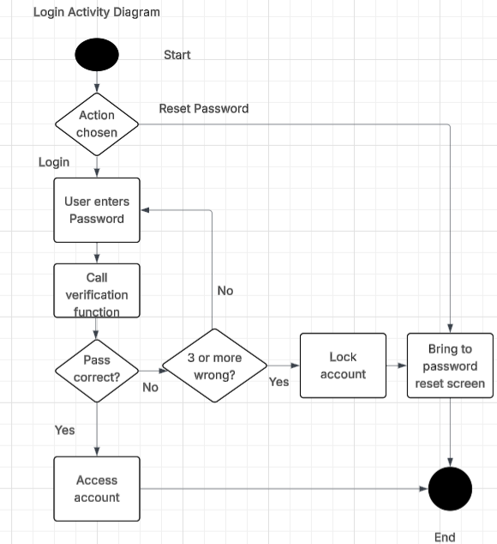
Activity Diagram
[Insert one of your activity diagrams here.]
Notes:
This diagram shows one example of how the DriverPass app will be used, starting at the most important point: the login screen. This screen will be used for both instructors and students.
First, the user will pick whether he or she wants to login, or to reset the password. If the user chooses to just reset the password, a reset email will be sent, and the screen will exit.
But if the user want to login, he or she will enter the username and password, and the server will check if it’s correct.
If it is, they will be logged in as expected. If not, the user will get to try again.
However, they can’t keep trying to log in forever. DriverPass needs to be secure, especially because it might store financial information to allow users to easily pay bills, and many hackers will set up robots to spam millions of password attempts, trying to guess the right one. Therefore, after 3 wrong attempts, the user will be locked out of the account, and forced to reset their password, and the login screen will exit until after the password is reset.

Slide 5
Security
Password and email required to login
Forced reset after 3 wrong attempts prevents robotic guess (“brute forcing”)
Passwords stored in scrambled form using “cryptographic hashes”
Use of secure, up-to-date infrastructure
Notes:
DriverPass may store credit card information to allow users to pay their bills, and even if it doesn’t, it is important that no fake appointments are made, which would cost the company business. Thus, security is very important for this app.
The first layer of security is requiring an email and password to login. This alone will prevent very simple hacking attempts or prank usage.
However, hackers can have robots attempt millions of guesses at a user’s password, in what is called a “brute force” attack. To prevent this, the user has their account locked and is forced to reset their password after a given number of attempts, and we chose 3 here for a mix of security and convenience.
But sometimes even that isn’t enough, as hackers could gain access to the server that stores the passwords. To fix that, the passwords themselves won’t be stored on the server. Instead, it will be scrambled through what’s called a “cryptographic hash” function, creating a seemingly random set of numbers. It’s easy to tell if the password is correct by applying this scrambling function, but almost impossible to go from the scrambled number to the password.
And finally, using secure and regularly updated infrastructure will help keep the app safe. For instance, Windows Server or a regularly updated Linux equivalent will be used on the server that hosts the software.

Slide 6
System Limitations
Relies on modern computers or smartphones
Depends on reliable high-speed internet
Does not provide on-demand tutoring
Lessons limited by number of instructors
Notes:
While this software will help DriverPass’s business, it still has some limitations. For instance, it depends on both instructors and students having access to modern computers or smartphones, and also on them having reliable and fast internet connections.
In addition, while the DMV list of rules is a great help, this might still be confusing to some students. If that’s so, they will have to wait until there is an appointment available to have an instructor clear up their confusion, as it doesn’t provide on-demand tutoring.
Finally, the app can’t teach actual driving skills like a simulator could, so lessons are limited by the number of instructors. This limits its reach to the local area and a limited number of students, instead of letting DriverPass have a nationwide customer base.

